Slide 1
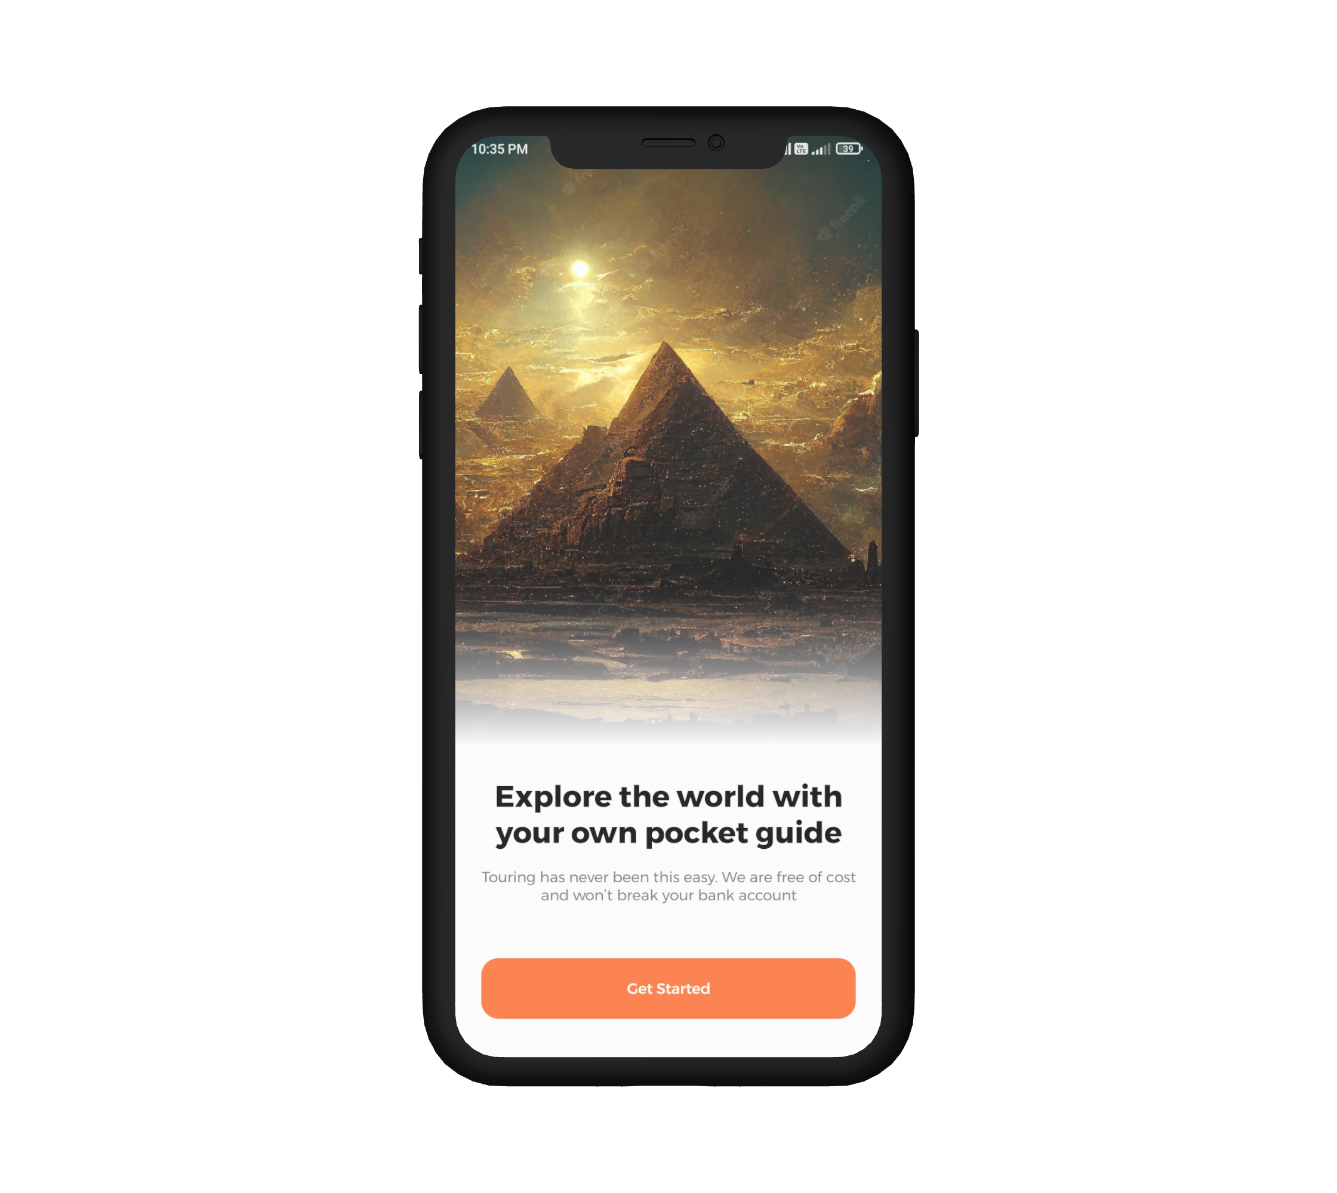

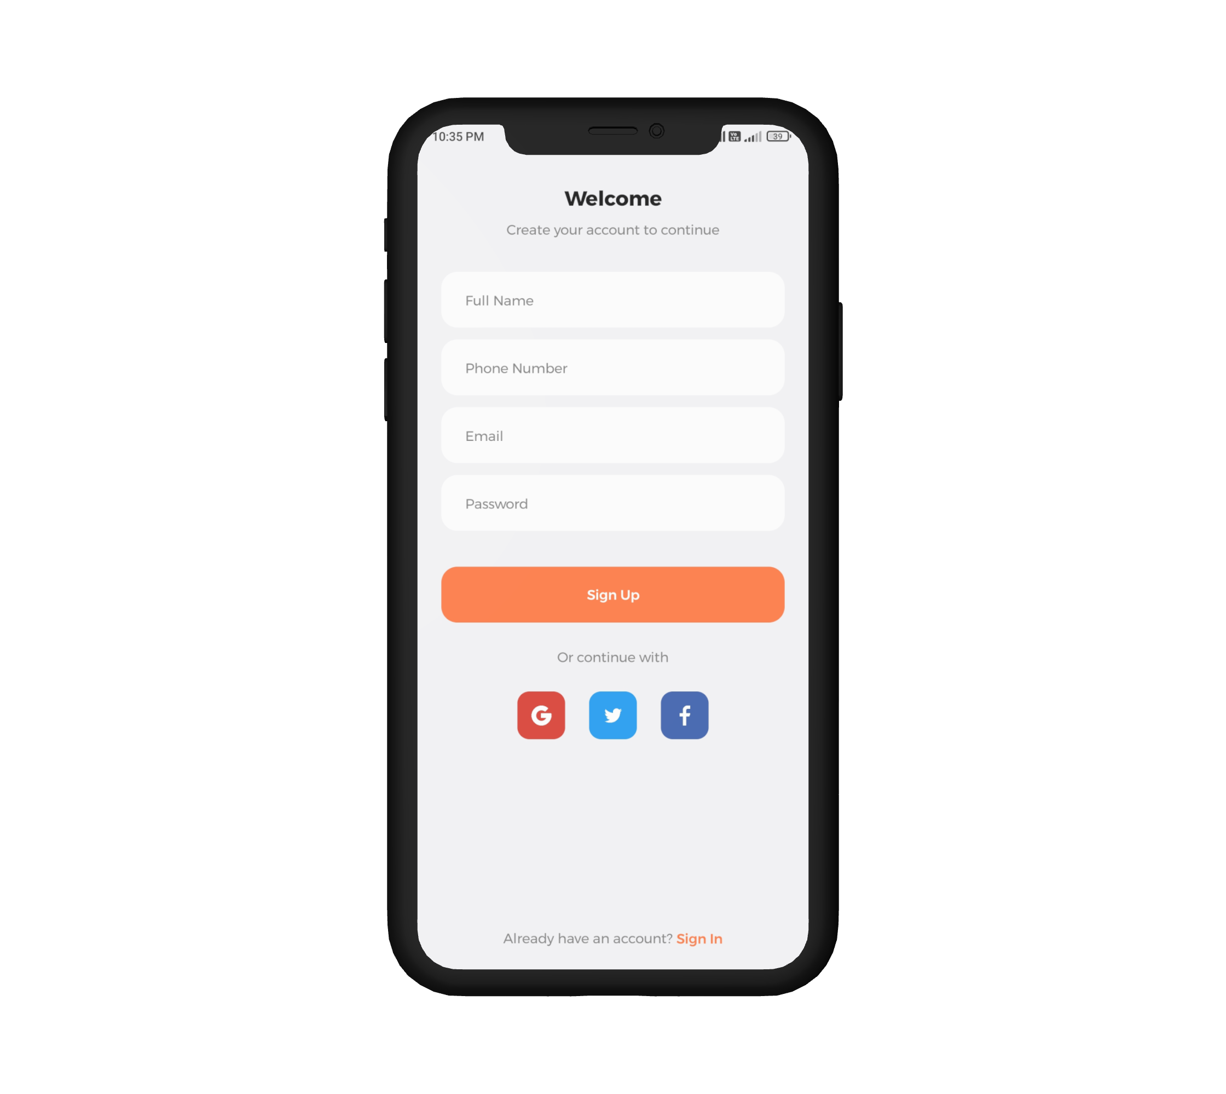

A presentation on Tour Guide Application
Department of Computer Science & Engineering
Haldia Institute of Technology, Haldia, 2022
Submitted By :
Submitted To:
Mr. Aniruddha Das
Shrayan Bandyopadhyay (CSE)
Adrian Sajjan (CSE)
Aheri Mondal (CSE)
Aritra Ghorai (CSE)
(Project Guide)
Slide 1 of 15

Slide 2
Table of Contents
1. Introduction to Tour Guide Application
2. Introduction to Exploriana
3. System Requirements Analysis
4. Languages Used
5. Android Activity Lifecycle
EXPLORIANA
6. Project Updates
7. Design Flowcharts
8. Format of Database
9. Future Working Plan
10. Thank You
Slide 2 of 15

Slide 3



01
Introduction to Tour Guide Application
Tour guide application is a software that is used to assist tourists on their visit to a travelling location. Tour guides are professionals in the travel sector who show tourists around interesting locations. They can take groups or individuals on excursions through historical sites, museums, popular spots and other locations.
Some examples are:
Slide 3 of 15

Slide 4
02
Introduction to Exploriana
EXPLORIANA
Slide 4 of 15

Slide 5
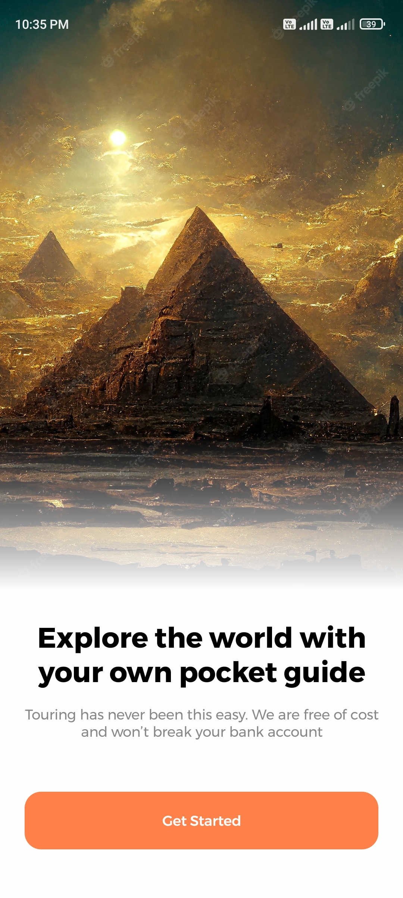
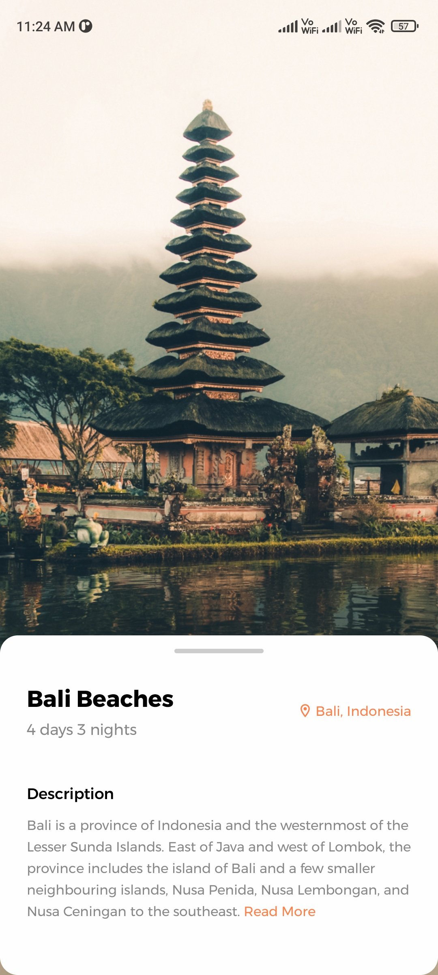
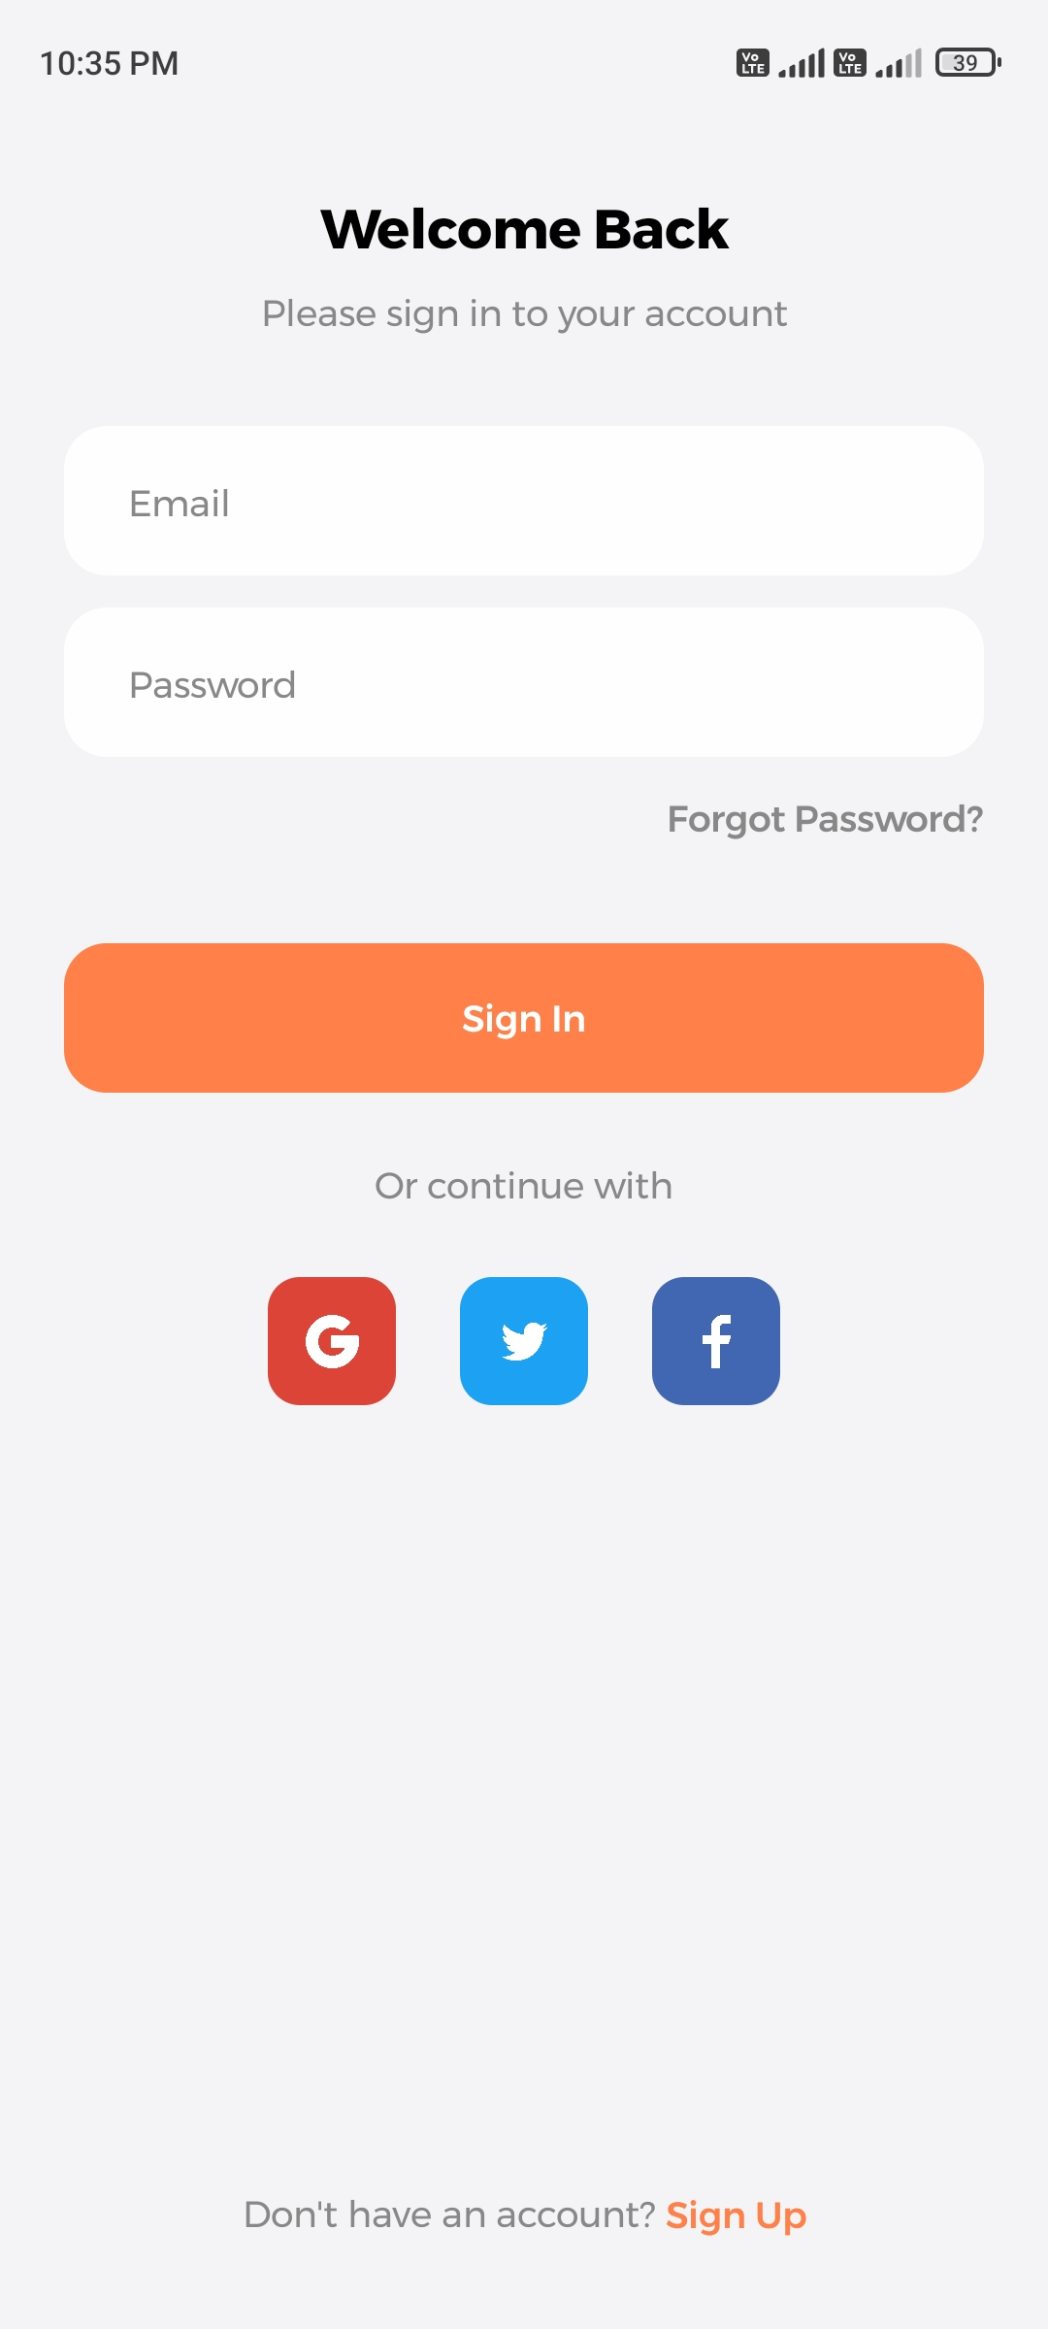
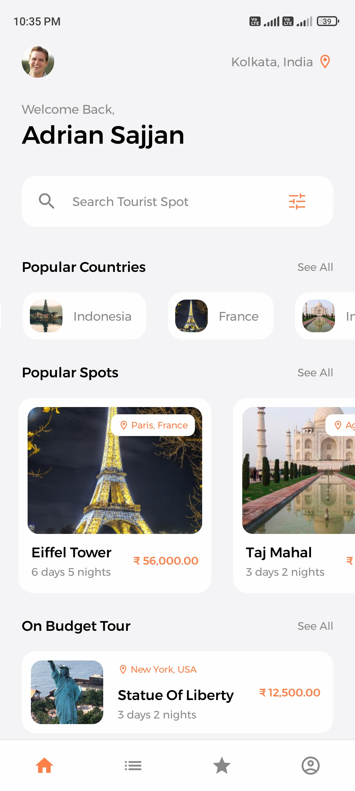
02
Introduction to Exploriana
EXPLORIANA is a software developed by our team of 4 to assist travelers in learning detailed information about major tourist destinations and places to visit in different countries.
Slide 5 of 15

Slide 6





03
System Requirements Analysis
Operating Environment (Frontend)
Operating System
Android Studio
Android
VS Code
Operating Environment (Backend)
Database
Node.Js
PostgreSQL
Slide 6 of 15

Slide 7

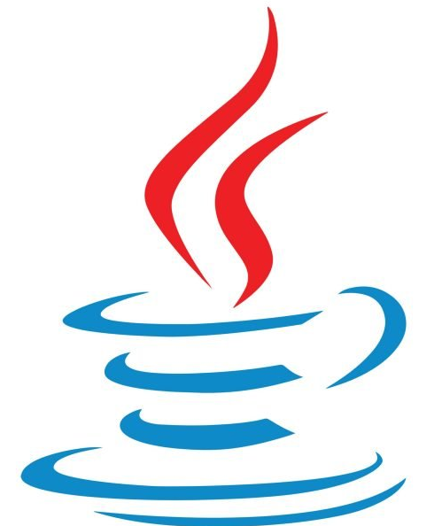




04
Languages Used
Programming Languages Used
Java
PostgreSQL
React Native
TypeScript
Slide 7 of 15

Slide 8
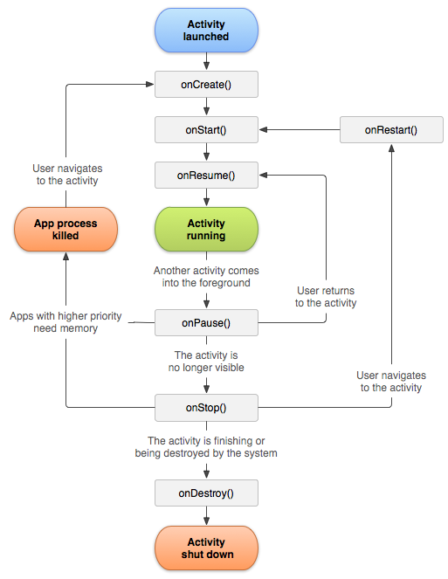

05
Android activity lifecycle
Slide 8 of 15

Slide 9
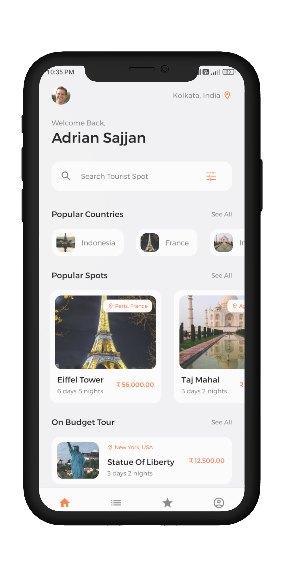
06
Project Updates
Get Started
Sign Up
Home
01
02
03
Slide 9 of 15

Slide 10
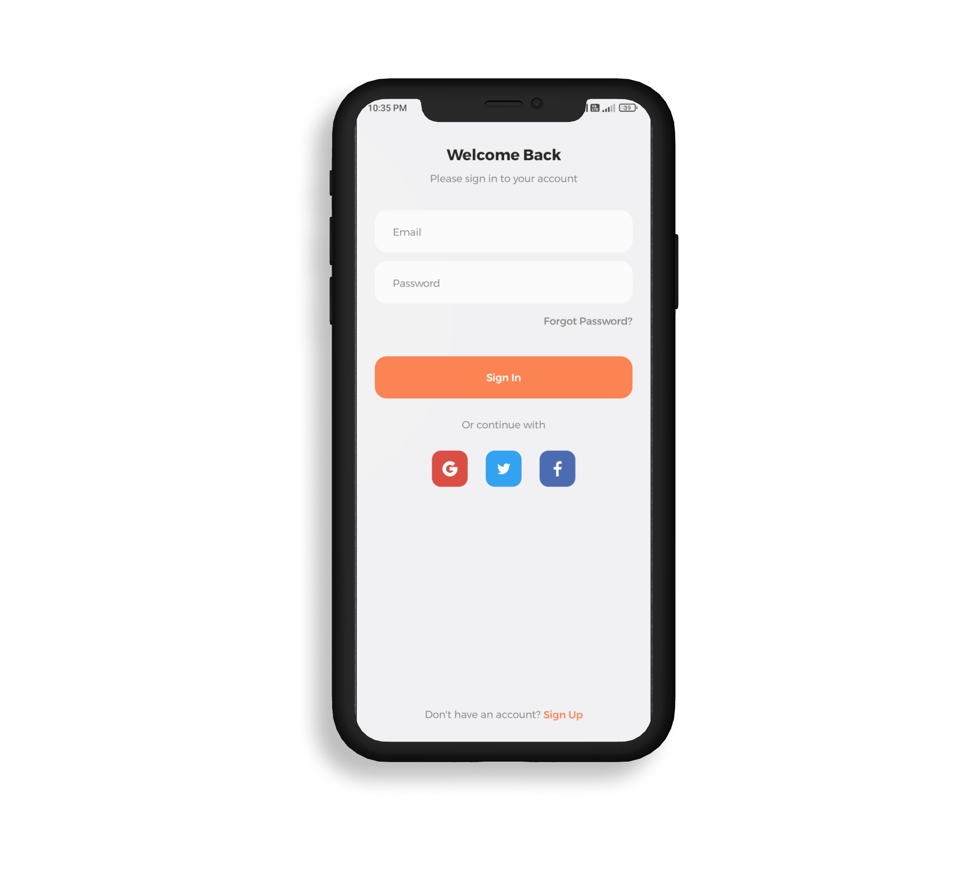
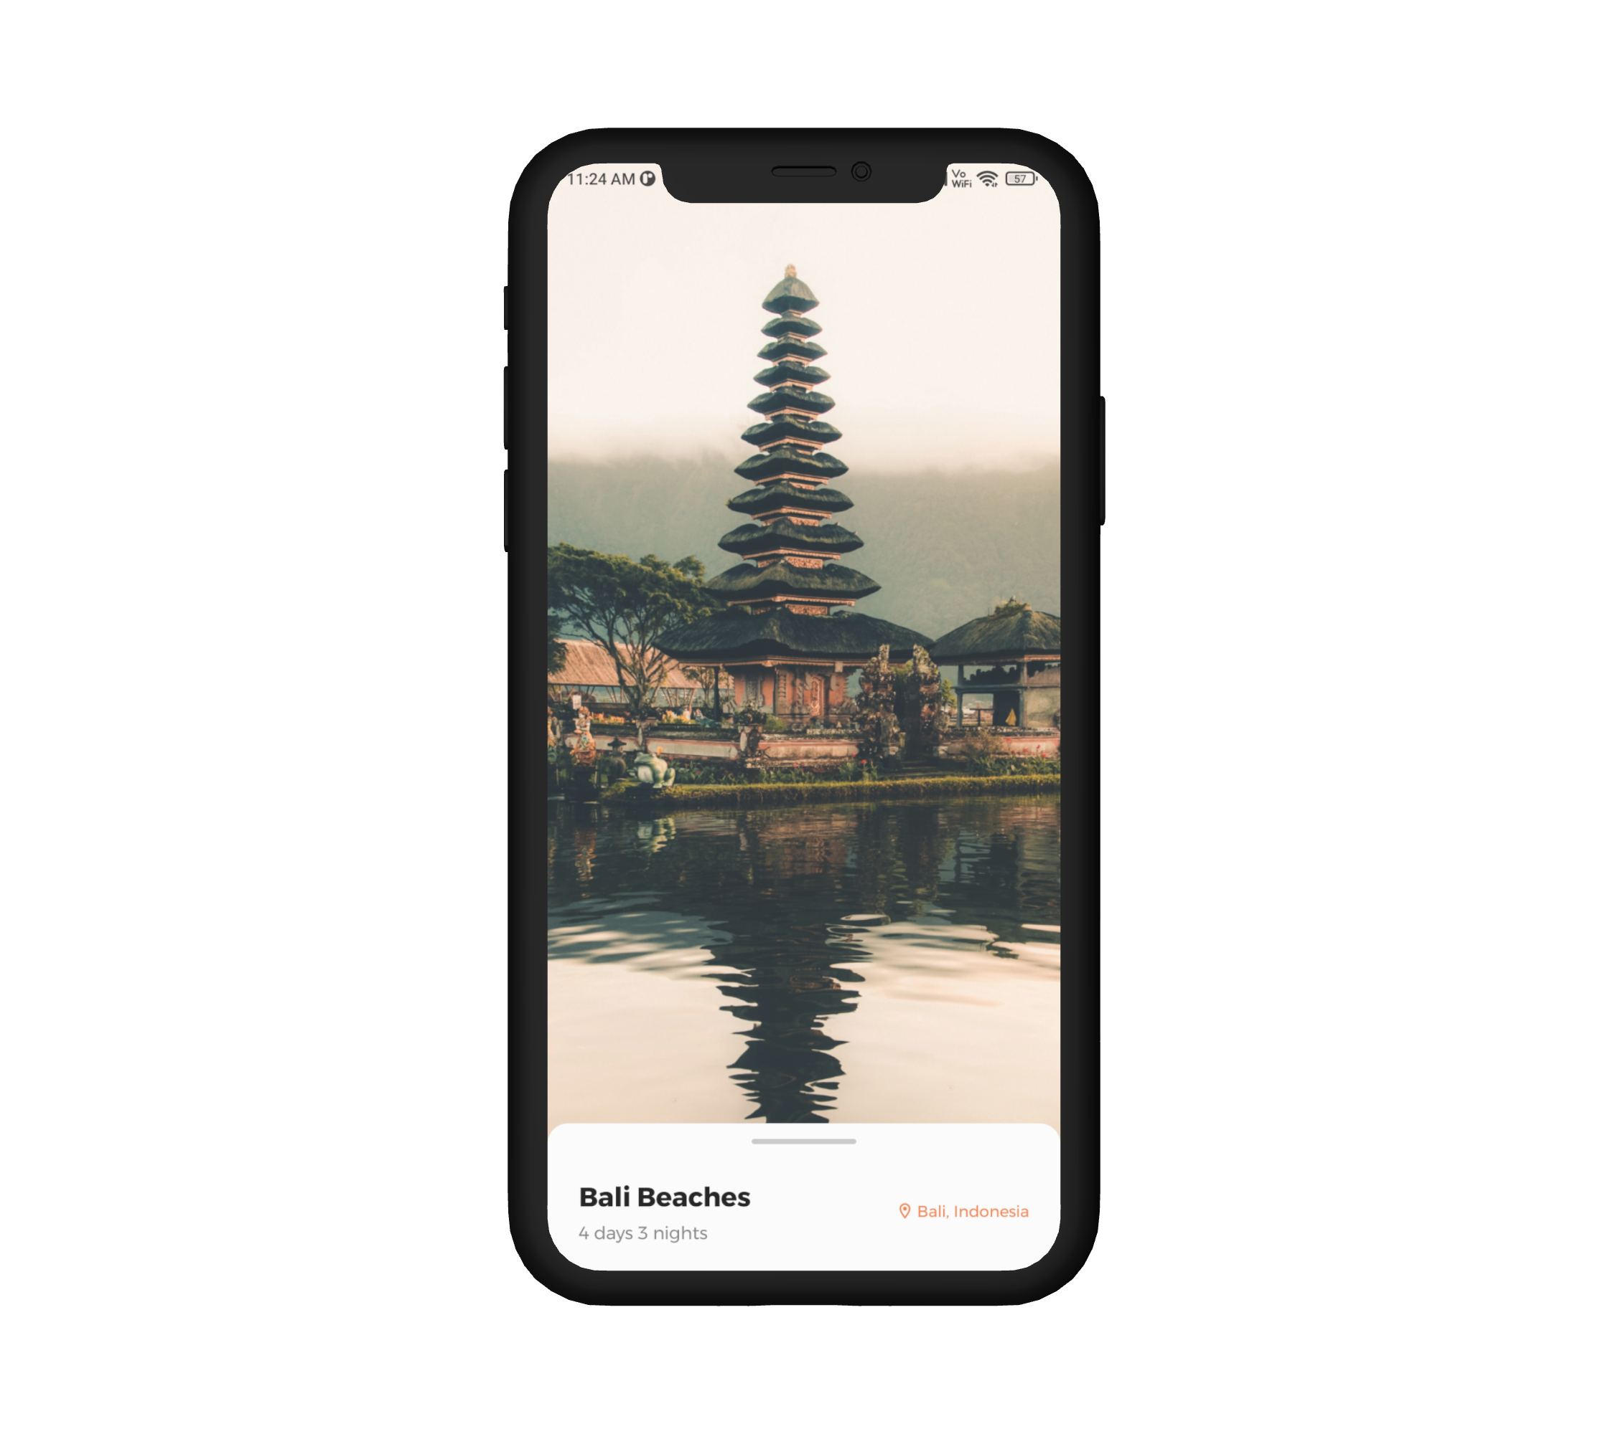
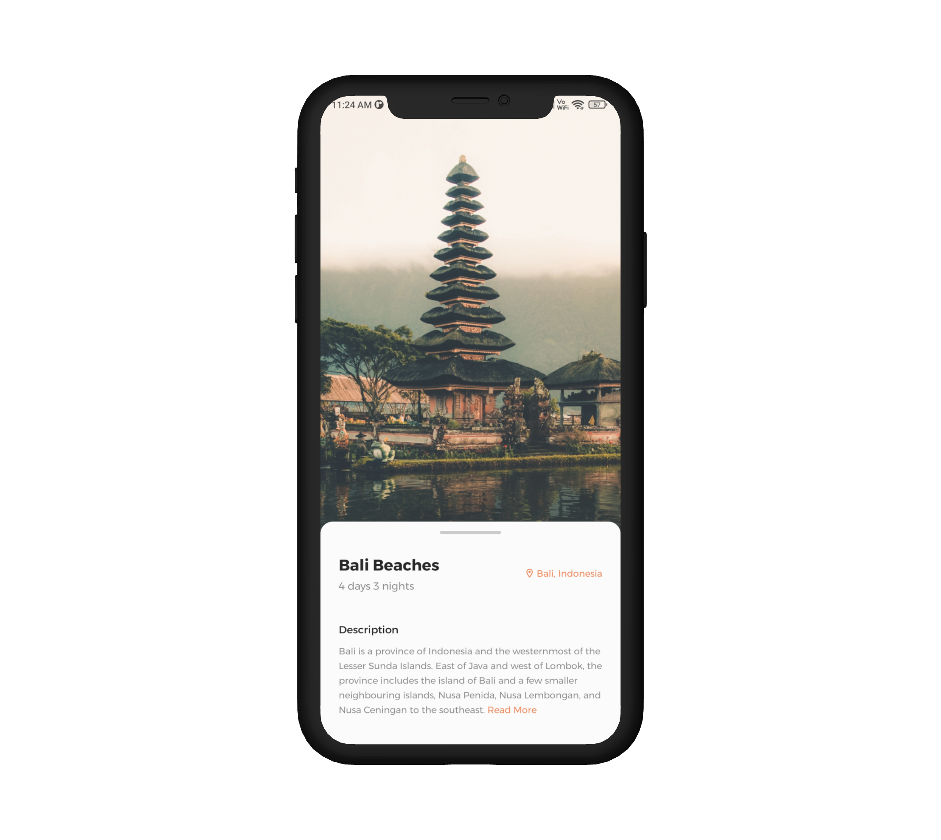
06
Project Updates
Log In
Tour Overview
Tour Details
04
05
06
Slide 10 of 15

Slide 11
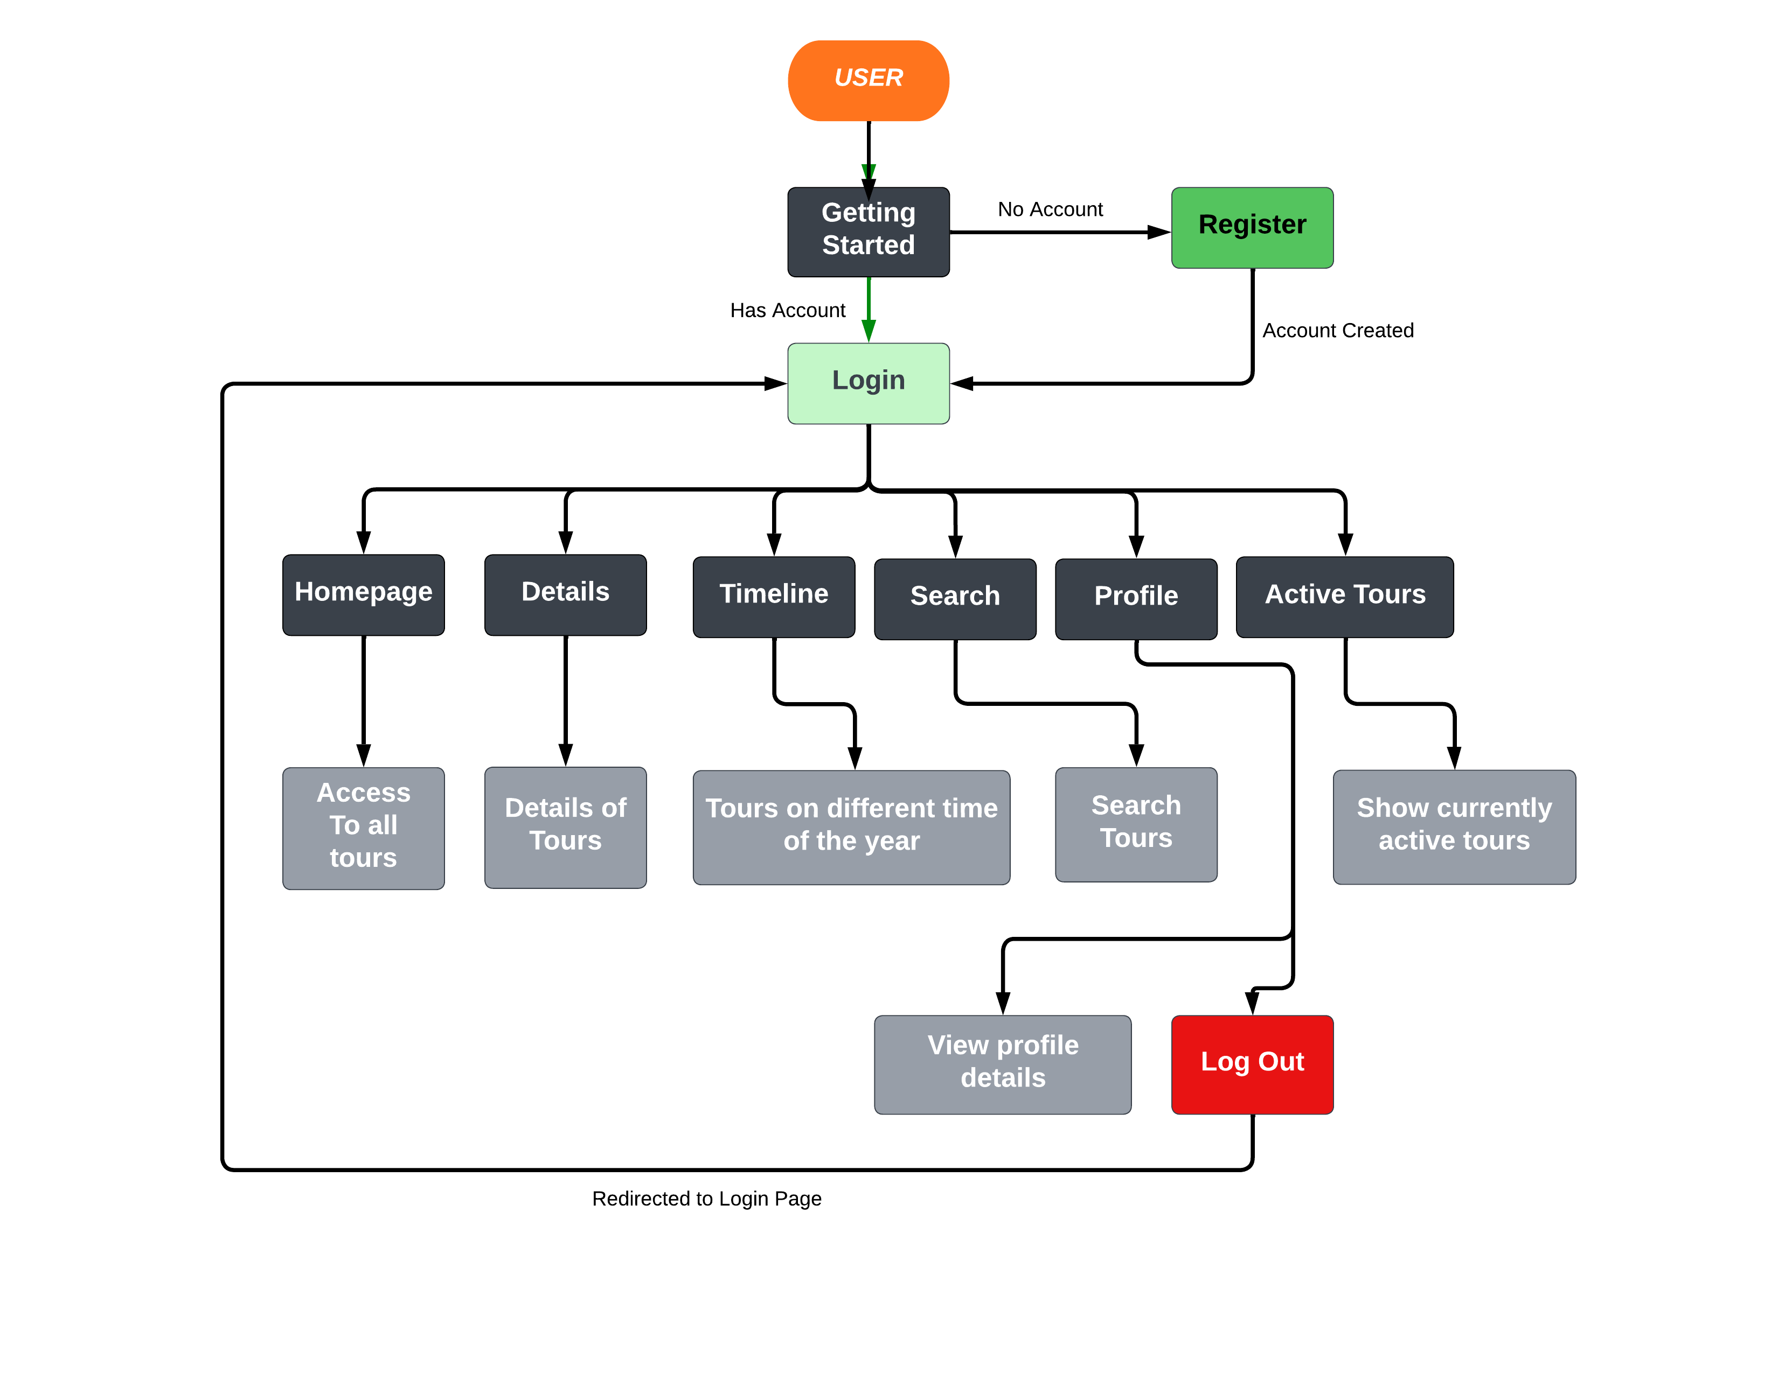
07
Design Flowchart
Slide 11 of 15

Slide 12






















































































08
Format of database
PostgreSQL is being used as the backend database for our Tour Guide Application, EXPLORIANA.
Why it is used?
Easy distribution
Data organized into rows and columns
Ease of use
Open-Source Software
Relational Database
Reliable due to presence of large community
Slide 12 of 15

Slide 13
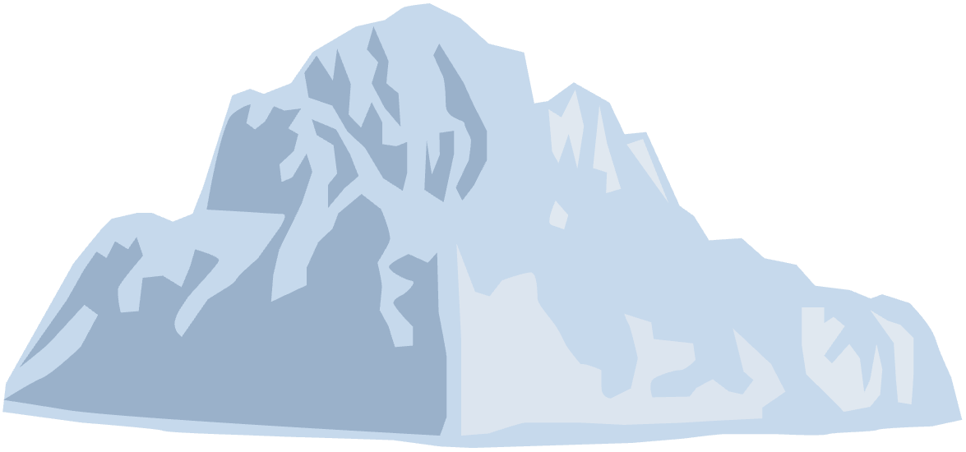


09
Future working plan
1
Willing to expand the database
2
Add new features
Provide new updates
4
3
Release on Google Play Store
Slide 13 of 15

Slide 14
08
References
www.stackoverflow.com
www.reactnative.dev
www.wikipedia.org
www.expo.dev
www.developer.android.com
www.typescriptlang.org
www.quora.com
www.medium.com
Slide 14 of 15

Slide 15
a
Thank you for watching!
For any queries:
Adrian Sajjan : adriansajjan2001@gmail.com
Aheri Mondal : aheri.mon@gmail.com
Aritra Ghorai : aritra1521@gmail.com
Shrayan Bandyopadhyay : shrayan.bandyopadhyay2@gmail.com
Slide 15 of 15

